Slide 1
19th Annual Valley Shores HOA Meeting
Pines County Club
Sunday February 11th, 2023 @ 2:00-3:00 P.M.
Call to Order
Introduce Board of Directors – Gregg E
– Outgoing President remarks & New President Intro
III. Election of Board of Directors– Jimmy
– Member At Large
IV. Treasurer Report - Greg H
V. Board Reports
- Fish Committee Report –
- Design Review Board –
- Boat Ramp Design Committee - Jimmy
Old Business
- Ground Builders Agreement – 2025
- Garbage Agreement – 2025
- HOA Liability Insurance
- Food Trucks – Stephanie
- Lake Quality – Joel
- 4th of July Fireworks (5 July 2024) – Jimmy
- Directory –
VII. New Business
VIII. Adjournment

Slide 2
Valley Shores HOA Board of Directors
Eric Gottuso President 1 Year Remaining
Jimmy Dean Vice President 1 Year Remaining
Greg Harr Treasurer 3 Year Remaining
Joel Sedlacek Secretary 2 Years Remaining
Tim Milliti Member 3 Years Remaining
Members At Large
Stephanie Lewis- Lakefront Lot
Vacant - Golf Course Lot
Notes:
Craig retiring with 8 years on the HOA Board
Joe Herman retired with 7 years on the HOA Board

Slide 3
Members at Large Position
A single vacancy available
Non-voting member
Provides continuity to Board
Provides valuable experience to the Board
Eric Gottuso, Joel Sedlacek and Tim Milliti former Members At Large
If Interested please contact Jimmy or any HOA Board member
Golf Course Resident preferred

Slide 4
Treasurer’s Report
Visit Valuation Lookup » DC Assessor
Your Total Home Valuation – Increased Dramatically
Use your parcel ID from Tax documents to research your property

Slide 5
Fish Committee Report
Committee Members:
Ryan Moss, Kyle Reit, Eric Novotny, Chuck Hascall, Randy Bailey, Bill Wilcox
No stocking performed in 2023, there are funds in the budget for 2024
Fish habitat available for placement/No Christmas Trees
Golf Course members are allowed to fish on the boat ramp lot/frozen lake
Must pay $100 fee with their annual HOA dues (Keith Uekert, Ted Paasch)
Guests fishing MUST be accompanied by Property Owner
Please ensure you/guests are aware of fish limits/per lot-not individual
Know the Rules before you fish. Fish Rules/Limits posted to the Valley Shores Website – Rules and Covenants | Valley Shores (valley-shores.com)
Rules violations will result in $200 fine per violation
Notes:
Property owner not only should be present to ensure fish limits etc but for Zebra Mussel protocols are followed

Slide 6
Design Review Board
Gary Wasco
Joe Hurd
Steve Hansen
Valley Shores residents - subject matter experts in construction
All new plans for home and outdoor additions to include fencing and significant landscaping will be reviewed by the new DRB
DRB will work with homeowners if adjustments need to be made to meet covenants
DRB will recommend approval/disapproval to the HOA Board

Slide 7
Boat Ramp Design Committee
Limestone blocks to be installed to create barrier between grass and sand
HOA Board is researching possible sand point well to provide irrigation/sprinkler system to the lot

Slide 8
Ground Builder’s
Contract (2023-2025)
Dependable
Local
Responsive
Cost Savings

Slide 9
Garbage Contract
Contract (2023-2025)
Residential Waste Management Services - Waste Connections
Cost Savings
Garbage Dues $225 annually
($18.75 per month) per household
Reduces Heavy Vehicle Traffic on our Street
Website provides info on schedule as well as criteria for items to be picked up

Slide 10
HOA Liability Insurance
Increased Liability Insurance from $1M to $2M
Smith Davis Insurance – Council Bluffs IA
$1M premium was $906.80 annually
$2M premium is $1326.20 annually
New Policy went into effect 1June 2023

Slide 11
2024 Food Truck Schedule
May 29 La Cabanita
June 5 Corn Dog Company
June 15 Donut NV
June 19 Family Traditions BBQ
June 24-27 Open
July 1-5 -Open
July 8-12 Open
July 17 - H7 Eats
July 23 Greek to Me
July 29 Javis Tacos
August 5-9 Open
August 12-16 Open
Volunteer Opportunity
Thanks to Stephanie Lewis
Notes:
Stephanie Lewis

Slide 12
Lake Quality
Nebraska Lake Management – Rob Hofpar
2024 Budget Proposal –
Purchase one additional ultrasonic
Locate at Michael and Tricia Wesley’s dock adjacent to the boat ramp lot
Monitoring capabilities for all three units
Funds set aside for Cutrine Plus treatments if needed
Notes:
Some Lakes do not allow a boat to return if they have been in another body of water for the remainder of the season
Require invoice as proof of work when boats are removed during season for maintenance
Require proof of HOTSY (High Pressure Hot Wash) before a boat can be returned to the lake after being in another body of water

Slide 13
Ultrasonic Line Of Sight Coverage

Slide 14
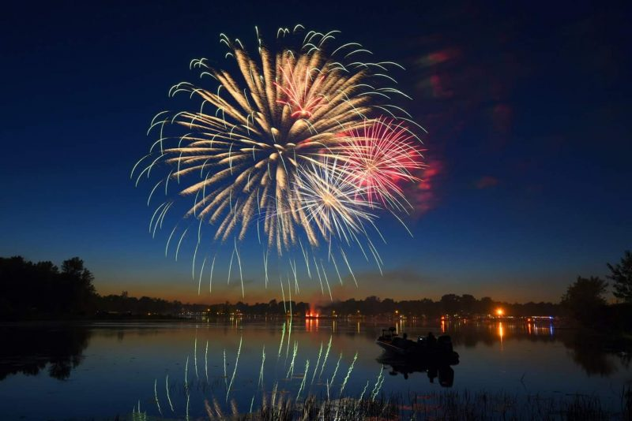
4th of July Celebration
Event Date: Friday 5 July 2024 @ Dusk
Annual Budget: $9K
New Vendor – Wald Fireworks – Ginger Cove and others for many years
Fundraising Efforts will continue in 2023 to cover increased cost
Yard Signage for any donation
Last year over $3200 was raised

Slide 15
Directory/Contact List
Valley Shores Directory & Contact List
Please utilize the Website – let us know if there are things that you would like to see added to make the website more helpful/useful
Review Directory
Ensure Accuracy
Used to generate/distribute mass emails inform community of significant information relating to the neighborhood
Used for annual mailings (i.e. Annual Dues and HOA Board Member Voting etc.)
Email valleyshoreshoa@gmail.com with updates/corrections

Slide 16
Recognition of Volunteer/Contributions
Jim & Ann Taylor -
- Served on board for many years & continues to assist with boat ramp access
Russell Westergaard -
- Excavates the boat ramp, beach work and snow clearing for many neighbors
Bob & Mary Sindelar -
- Volunteered to allow an ultrasonic and control panel to be installed on their dock
Kyle Reit -
- Volunteered to allow an ultrasonic and control panel to be installed on their dock
Mike & Tricia Wesley -
- Grades the Boat Ramp Beach
- Volunteered to allow an ultrasonic and control panel to be installed on their dock
Linsey Bellinger -
- Organizes the Annual 4th of July Parade
Marty Sehn -
- Organizes the Annual Easter Egg Hunt
Christie Dean -
- Takes meticulous notes at all HOA Board meetings to distribute to the community

Slide 17
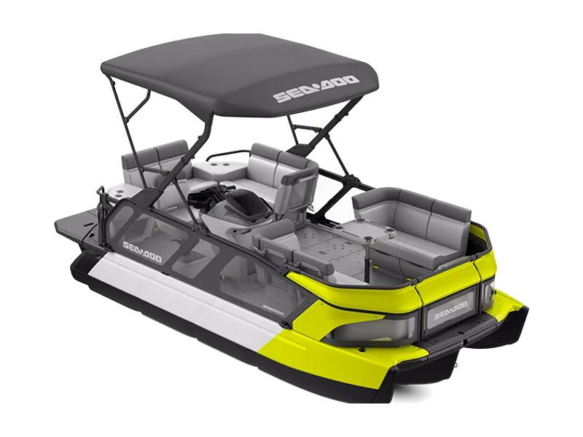
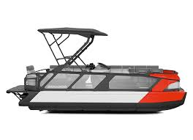
New Business
- SeaDoo Switch
- Leisure Sports performed demonstration last Oct
- Another demonstration to be held in spring to allow more
residents to observe
- Would require Covenant changes
Allowing jet boats
Allowing specific pontoons to pull tubers etc
Allowing for larger engine sizes on pontoons

Slide 18
Adjournment

