Slide 1
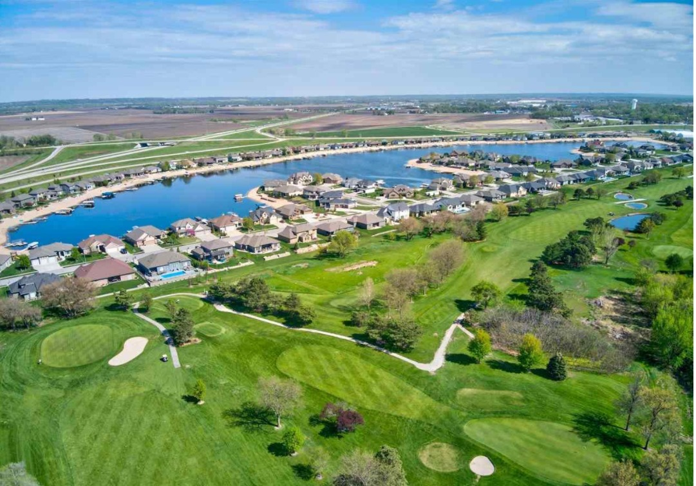
18th Annual
Valley Shores HOA Meeting
Pines County Club
Sunday February 12th, 2023 @ 1:00-2:00 P.M.
Call to Order
Introduce Board of Directors – Craig
– Outgoing President remarks & New President Intro
III. Treasurer’s Report – Greg Harr
IV. Board Reports
- Fish Committee Report – Gregg
Election of Board of Directors – Member At Large – Jimmy
Old Business
- Update on Ground Builders Agreement – Craig
- Update on Garbage Agreement – Eric
- Update on Liability Insurance – Eric
- Design Committee Boat Ramp – Jimmy
- Food Trucks – Gregg
- Lake Treatments – Gregg
- Fireworks (1 Jul 2023) – Joel/Gregg
- Directory – Gregg
VII. New Business
– No new business has been submitted
VIII. Adjournment

Slide 2
Valley Shores HOA Board of Directors
Gregg Englert President 1 Year Remaining
Jimmy Dean Vice President 2 Years Remaining
Greg Harr Treasurer 1 Year Remaining
Eric Gottuso Secretary 2 Years Remaining
Joel Sedlacek Member 3 Years Remaining
Members At Large
Tim Milliti - Golf Course Lot
Vacant - Lakefront Lot
Notes:
Craig retiring with 8 years on the HOA Board
Joe Herman retired with 7 years on the HOA Board

Slide 3
Treasurer’s Report
Visit Valuation Lookup » DC Assessor
  Your Total Home Valuation – Increased Dramatically
  Use your parcel ID from Tax documents to research your property

Slide 4
Fish Committee Report
Committee Members:
Ryan Moss, Todd Young, Kyle Reit, Randy Bailey, Bill Wilcox
Nov 2022– 700 Fingerling Walleyes Stocked by Nebraska Lake Mngmt.
Golf Course members are allowed to fish on the boat ramp lot/frozen lake
  Must pay $100 fee with their annual HOA dues
  Three residents participated: Jorgensen, Ueckert, Paasch
  Guests fishing MUST be accompanied by Property Owner
Please ensure you/guests are aware of fish limits/per lot-not individual
Know the Rules before you fish. Fish Rules/Limits posted to the Valley Shores Website – Rules and Covenants | Valley Shores (valley-shores.com)
Rules violations will result in $200 fine per violation
Notes:
Property owner not only should be present to ensure fish limits etc but for Zebra Mussel protocols are followed

Slide 5
Members at Large Position
A single vacancy available
Non-voting member
Provides continuity to Board
Provides valuable experience to the Board
  Eric Gottuso & Joel Sedlacek former Members At Large
If Interested please contact Jimmy or any HOA Board member

Slide 6
Ground Builder’s
New 3 year contract (2023-2025)
Dependable
Local
Responsive
Cost Savings

Slide 7
Garbage Contract
New 3 year contract (2023-2025)
Residential Waste Management Services - Waste Connections
Cost Savings
  Garbage Dues did increase from $175 to $225 annually
  ($18.75 per month) per household
Reduces Heavy Vehicle Traffic on our Street

Slide 8
HOA Liability Insurance
Increased Liability Insurance from $1M to $2M
  Smith Davis Insurance – Council Bluffs IA
  $1M premium was $906.80 annually
  $2M premium is $1326.20 annually
  Old policy expires/New Policy goes into effect 1 June 2023

Slide 9
Boat Ramp Design Committee

Slide 10
2023 Food Truck Schedule
Wednesday May 31 - Cheese Life
Thursday June 8 - H7 Eats
Monday June 12 - Greek to Me
Tuesday June 20 - La Cabinita
Thursday June 29 - 402 BBQ
Thursday July 6 - Streetside Foods
Wednesday July 12 - H7 Eats
Wednesday July 19 - Pims Thai
Thursday July 27 - Cheese Life
Tuesday August 1 - La Cabinita
Week of Aug 8 Javi’s Tacos
Wednesday August 16 - Pims Thai
Week of August 20 OPEN
Week of August 27 - OPEN
Be on the look out for Shaved Ice/Ice Cream and Desert Trucks too
Thanks to Stephanie Lewis
Notes:
Stephanie Lewis

Slide 11
Lake Treatments
Nebraska Lake Management – Rob Hofpar
  Awaiting 2023 Budget Proposal – 2022/$2050 per treatment
  2022 Total Lake Maintenance Budget -$14K
  Awaiting Alternatives to previous treatment option (Cutrine Plus)
    Bacteria Based Products with Phosphate Binders
    Ultrasonic Algae Treatment – is this financially feasible/effective for our lake
West Omaha Lake Association (WOLA)
  Area Lake HOA Board Members – discuss common lake community issues
  Establish standardized zebra mussel protocols
    Could lead to stricter timeline for boat returns and/or sanitation procedures
  Establish approved vendors using standardized requirements
    Think about equipment that may touch the water when hiring a vendor to perform work
  March Meeting – focuses on Lake Algae treatments
Notes:
Some Lakes do not allow a boat to return if they have been in another body of water for the remainder of the season
Require invoice as proof of work when boats are removed during season for maintenance
Require proof of HOTSY (High Pressure Hot Wash) before a boat can be returned to the lake after being in another body of water

Slide 12
Fireworks
Event Date: Saturday, 1 July 2023
  Budget: $9K
  Fundraising Efforts will continue in 2023
  Yard Signage for any donation
  Last year over $3200 was raised

Slide 13
Directory/Contact List
Valley Shores Directory & Contact List
  Please utilize the Website – let us know if there are things that you would like to see added to make the website more helpful/useful
  Review Directory
  Ensure Accuracy
    Used to generate mass emails
    Used for annual mailings (i.e. Annual Dues and HOA Board Member Voting etc.)
    Email valleyshoreshoa@gmail.com with updates/corrections

Slide 14
New Business

Slide 15
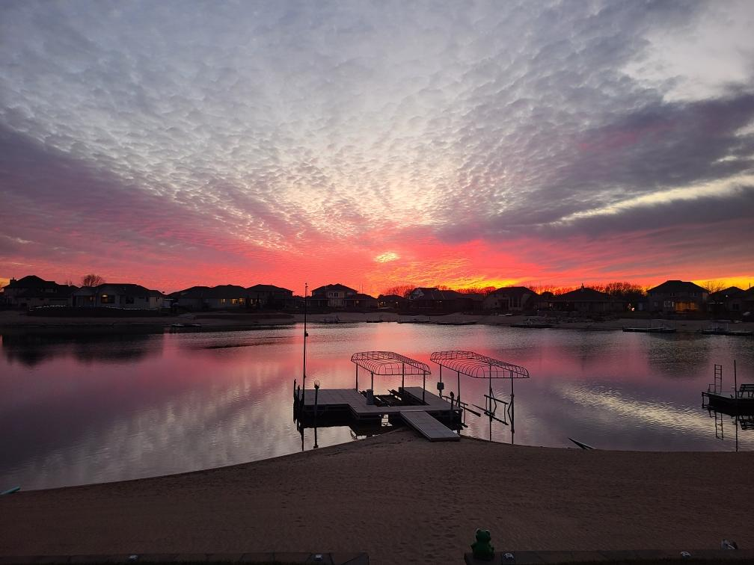
Adjournment

